Slide 1
Christianity Schism

Slide 2
Early Christianity = ILLEGAL
(practice in private)
Bishop
Congregation
Bishop
Congregation
Bishop
Congregation

Slide 3
Constantine’s Conversion 311
Edict of Milan
313
Council of Nicea 325

Slide 4
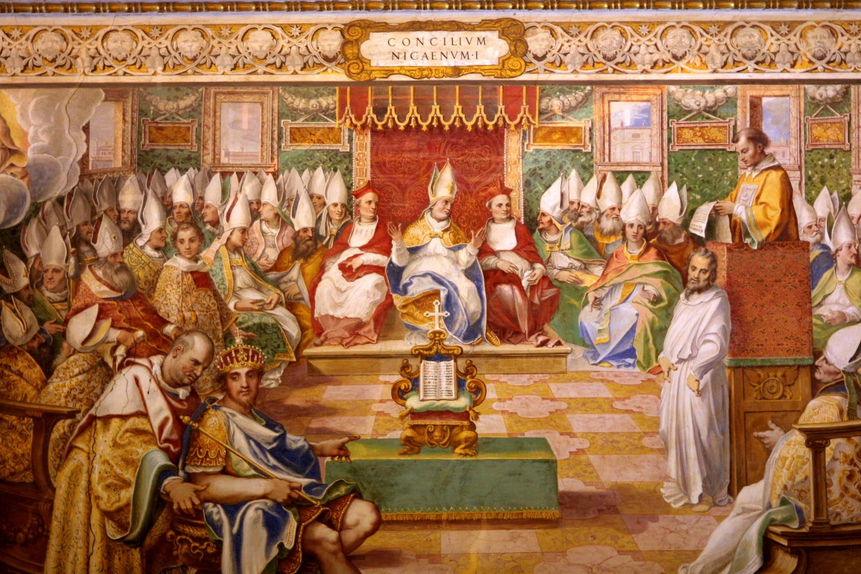
Council of Nicea

Slide 5
Patriarchates
Rome
Alexandria
Jerusalem
Constantinople
Antioch

Slide 6
Patriarchates by 661
Rome
Alexandria
Conquered by Muslims
Jerusalem
Conquered by Muslims
Constantinople
Antioch
Conquered by Muslims

Slide 7
Disagreements
Rome
Alexandria
Conquered by Muslims
Jerusalem
Conquered by Muslims
Constantinople
Antioch
Conquered by Muslims

Slide 8
Pope Leo IX vs. Patriarch Michael I
Causes, among others
Papal Authority
Filoque in Nicene Creed
Facial Hair
Celibacy of Priests
Leavened vs. Unleavened bread

Slide 9
Great Schism
Roman Catholic Church
Eastern Orthodox Church
Mutual Ex-communication in 1054

Slide 10
DCT
Write a paragraph in which you discuss causes and effects of the Christianity Schism.

