Slide 1
Hyperinflation in Germany

Slide 2
Background
After WWI, many new gov’ts formed in Europe
Ex. Russia, Italy, Austria, Hungary, Germany
Many of these had problems

Slide 3
Germany
1919 Germany set up new gov’t called Weimar Republic
Encountered probs b/c ppl blamed Jewish Weimar Rep. for losing war / Treaty of Versailles
Economic probs caused by reparations

Slide 4
Inflation
Germany didn’t raise taxes to pay for war
Instead, simply printed more money
After Germany lost, paper $ lost value
But Germany had to pay reparations, so needed more $
So printed more
Value of currency fell severely – inflation set in

Slide 5
Basic Costs
Ppl didn’t have enough for basic necessities, be/ everything rose in price
In 1918 loaf of bread cost less than 1 mark
1922 bread cost 160 marks
1923 bread cost 200 billion marks
Ppl took wheelbarrows of $ to buy food

Slide 6
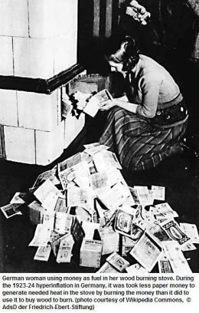
German Woman Burning Money as Fuel

Slide 7
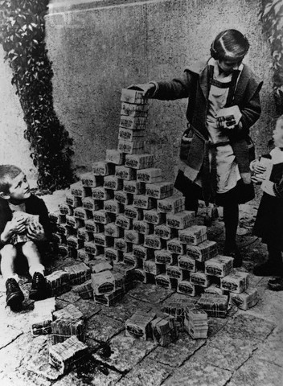
Children Playing in the Streets

Slide 8
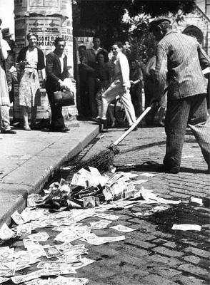

Slide 9
Economic Data
Workers paid daily and given time to shop before value of their wages fell
Housewives used small bills to fuel ovens b/c worth less than firewood
Depositors rec’d letters from banks informing them their life savings worth less than cost to maintain account

Slide 10
Economic Data
Entire annuity payments may be used for one loaf of bread and jar of jam
Ppl preferred to be paid in food rather than money

Slide 11
Discussion Points
Look at Charts 1 and 2:
1. During the early 1920s, much of Germany’s economy was based on barter. Discuss why.

Slide 12
Discussion Points
Look at Charts 3 and 4:
2. Discuss how hyperinflation affected Germany’s living standards. Analyze the changing spending patterns.
3. Why did food costs rise proportionally faster that rent?
4. What were the effects on the German diet?
5. What items were considered luxuries?
6. Not all Germans were affected equally. Why were retired people (pensioners) especially devastated?

Slide 13
Discussion Points
Look at the lyrics to the two songs:
7. They both have a lighthearted tone. What do the lyrics and tone tell us about German attitudes towards hyperinflation?

Slide 14
Discussion Points
Study charts 5 - 8:
Germany’s economic depression marked a turning point in German politics.
Each member of your group should choose a different voter profile. Read your profile, then discuss:
How the political attitudes of your voter would have been affected by the depression.
Which fears would most likely influence their views
How would the depression changed their view of the Weimar Republic?

Slide 15
Candidate One | Candidate Two
Remember Germany’s long and glorious past | Realize there are no quick solutions; be prepared to work hard and sacrifice for improvement
Replace present indecisive leadership with a strong, effective leader | Put people back to work, but realize it will take a lot of time
Rebuild the army to protect against enemies | Provide care for the elderly, sick and poor
Regain the lands taken unfairly from use | Avoid reckless military spending
Make change to return to economic health | Act slowly to safeguard democracy
Put the welfare of our country above all and our country will be great again | Be a good neighbor; honor all treaties and debts

Slide 16
Dawes Plan
Rest of world realized that Germany’s economy would need to be fixed for reparations pymts
1923 international committee headed by American banker Charles Dawes set up Dawes Plan
Plan gave $200 million loan from American banks to Germany to stabilize its economy & set new, more realistic plan for reparations
By 1929 Germany had begun rebuilding economy

