Slide 1
Stimulus Based Multiple Choice (MCQs)

Slide 2
Read / Analyze the Stimulus:
What is the purpose of the document / image?
What is the author saying?
What is the author trying to say? (read between the lines)
What is the author not saying/ what is not discussed?
What is going on in the rest of the world at this time? (contextualization)
Why is the author speaking / printing/ etc.? (causation)

Slide 3
Synthesize:
What you know about the topic from your reading and discussion
EVIDENCE from the document or prompt

Slide 4
Use good test taking strategies:
First eliminate answers that make no sense / contain false information
Look for “absolute” words (all, every, never, etc.) – those almost never are true
Try to narrow to two answers
Choose the one that makes the most sense AND that you can identify some type of evidence to prove in the question

Slide 5
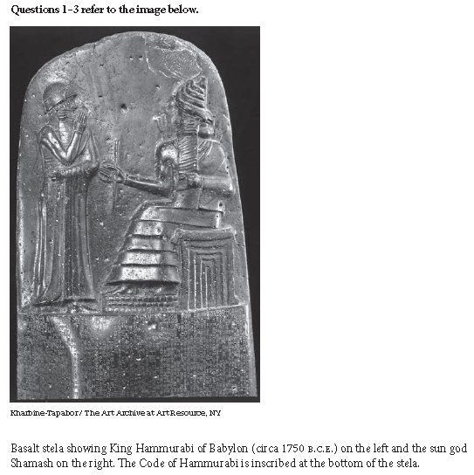
Let’s Practice

Slide 6
1. The relationship between Hammurabi and Shamash as depicted in the image best illustrates which of the following features of ancient civilizations.
Rulers deferred to the priestly class for religious guidance
Rulers asserted that royal laws were superior to diving laws.
Rulers created new religions to unify conquered peoples.
Rulers claimed that their authority derived directly from divine power.
Discuss with your group. Eliminate incorrect choices that don’t make sense and talk about why. Choose the best answer, then write a sentence with the EVIDENCE from the image that supports your choice.

Slide 7
2. In addition to commissioning the creation of objects such as the one shown in the image, rulers of early civilizations most commonly used which of the following activities to demonstrate their religious authority?
The creation of systems of record keeping
The creation of epic mythologies
The construction of water-control systems
The construction of monumental architecture
Discuss with your group. Eliminate incorrect choices that don’t make sense and talk about why. Choose the best answer, then write a sentence with the EVIDENCE from the image that supports your choice.

Slide 8
3. Which of the following best describes the significance of legal codes to early civilizations?
They granted citizens the right to choose their rulers and representatives.
They reflected and reinforced existing social and political hierarchies.
They facilitated the introduction of monotheistic religions.
They effectively settled disputes between pastoralist and agrarian communities.
Discuss with your group. Eliminate incorrect choices that don’t make sense and talk about why. Choose the best answer, then write a sentence with the EVIDENCE from the image that supports your choice.

Slide 9
Practice Individually
Complete the next set of questions on your own.

Slide 10
Short Answer Questions (SAQs)

Slide 11
Analyze the Prompt
Figure out what is the question is asking
Figure out what you know about the question
Remember ACE
Assert your claim
Cite your evidence
Give an example that proves your evidence

Slide 12
Plan Your Answer
Quickly list / jot down what you already know about the topic / question
Read the prompt (if you can write on the prompt, use CLOSE reading skills) – if not, write them on a separate sheet of paper
Underline main ideas
Circle words you don’t know
Write in the margins – author’s examples, your connections, etc.

Slide 13
Write Your Answer
Use complete sentences; an outline or bulleted list alone is not acceptable.
Separate your answer into part A, B, C
A. Blah, blah, blah, blah
B. Blah, blah, blah, blah

Slide 14
Practice
Source 1
In Mesopotamian societies the institutionalization of patriarchy created sharply defined boundaries between women of different classes, although the development of new the new gender definitions and of the customs associated with them proceeded unevenly. The State, during the process of the establishment of written law codes, increased the property rights of upper-class women, while it circumscribed their sexual rights and finally totally eroded them. The lifelong dependency of women on fathers and husbands became so firmly established in law and custom as to be considered “natural” and god-given. In the case of lower-class women, their labor power served either their families or those who owned their families’ services. Their sexual and reproductive capacities were commodified, traded, leased, or sold in the interest of male family members. Women of all classes had traditionally been excluded from military power and were, by the turn of the first millennium BC excluded from formal education, insofar as it had been institutionalized. – Gerda Lerner, The Creation of Patriarchy, 1986
Source 2
What was the real cause of the rise of patriarchy, which became increasingly oppressive to women in the Near East after Sumerian civilization waned? Several reasons suggest themselves. The first is militarism…Second, where commercialism held sway at the same time [as militarism] the worst examples of patriarchy were found. The third factor [for increasing patriarchy]: confidence [or more specifically, lack of confidence.] It is the threatened male and the threatened society…which created such a restricted role for women. – Barbara S. Lesko “Women of Egypt and the Ancient Near East,” 1987

Slide 15
Practice
Using the excerpts, answer a, b and c.
A. Briefly explain ONE major similarity between Gerda Lerner and Barbara Lesko’s historical interpretation about the rise of patriarchy.
B. Explain, using specific historical evidence, a political development that supported the development of patriarchy.
C. Explain, using specific historical evidence, an example of an economic impact that occurred as a result of due to the rise of patriarchy.

Slide 16
Practice Individually
Complete on your own, then compare answers with your partners. Be sure to discuss your EVIDENCE.

Slide 17
Historians have argued that the adoption of agriculture during the Neolithic Revolution was one of the most important transformations in human history.
Identify and explain ONE positive result of the Neolithic Revolution.
Identify and explain ONE negative result of the Neolithic Revolution
Identify and explain ONE feature that distinguished the Neolithic Age from the Paleolithic Age

