Slide 1
National History Day (Science fair for history)

Slide 2
What is NHD?
Pick your own subject (w/in topic of Taking a Stand in History)
Choose how you want to work (individually, with a partner or in a group of 3)
Do your own research
Present your work in a variety of ways!
Exhibit
Documentary
Website
Paper
Performance

Slide 3
Levels of competition
Classroom (required by all) – last week of November
District – January 11
County – March 18
State – May 6 – 7
National – date TBD

Slide 4
NHD Overview
https://www.youtube.com/watch?v=cqwRQYLxaYc

Slide 5
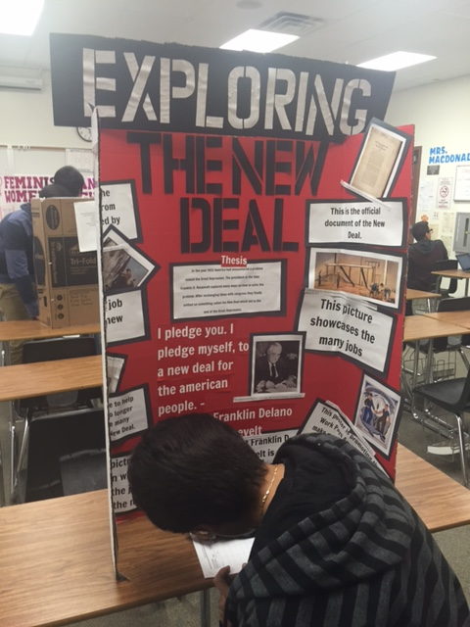
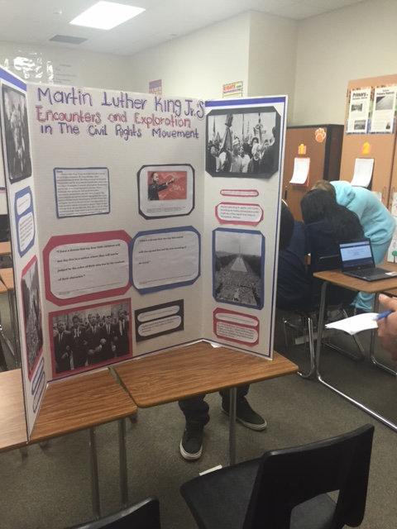
Examples

Slide 6
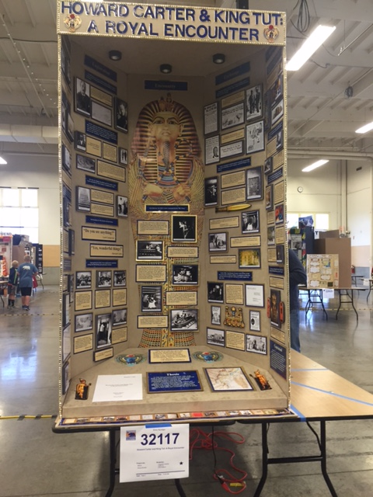

Slide 7
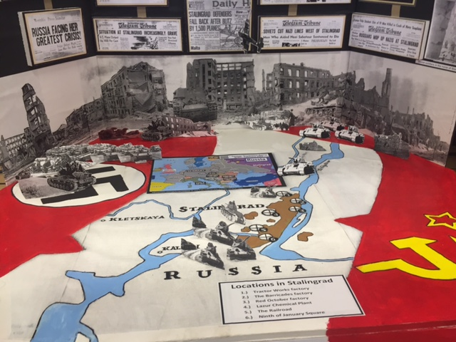

Slide 9
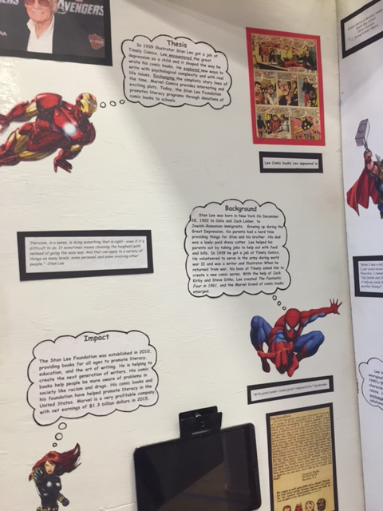

Slide 11
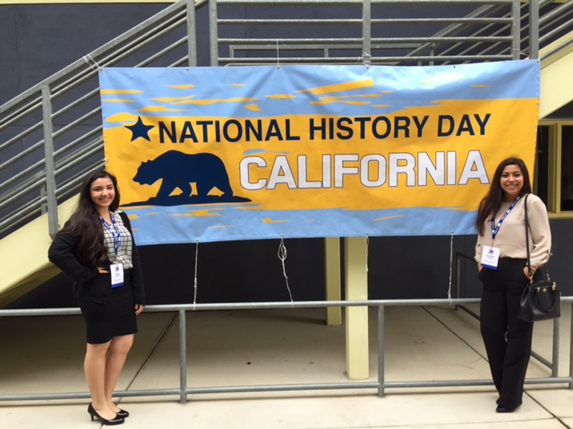

Slide 12
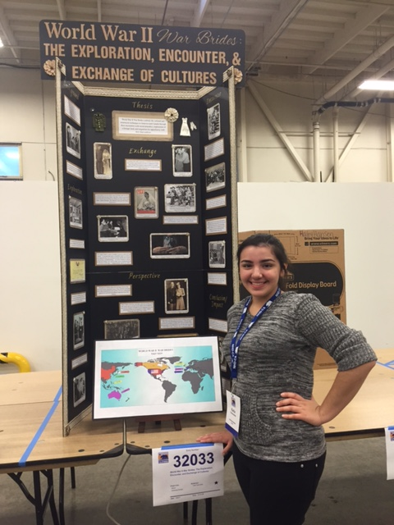

Slide 13
About the Topic
What does it mean?
Take a firm position on an issue and defend their position publically
Must overcome opposition
Doesn’t have to be someone famous ~ think outside the box
Ie, Martin Luther, protester in Tiananmen Square, Queen Liliokalani, Martin Luther King, Jr., Ghandi, Alexander the Great, Napoloeon, Catherine the Great, Alice Paul
Can a group of people take a stand?
Yes! Indian National Congress, American colonists, United Nations, temperance movement, MADD

Slide 14
Due through Google Classroom by SUNDAY, AUG. 28 at 11:59pm
Who you are working with (must be IN THIS CLASS)
Tentative topic
Why you chose that topic
For example:
I am planning on doing an individual project on “tank man” from Tiananmen Square in China. I choose this because I have been intrigued by this image since the first time I saw it on tv in 7th grade and I want to know what would possess someone to stand in front of a line of military tanks. I also want to know what happened to this person.

