Slide 1
Nationalism

Slide 2
As you watch each video, take notes on the process of nationalism /Decolonization.
Country fighting for independence | From where? | Process

Slide 4
As you watch The video, take notes on the process of nationalism.
Leaders: | Daily Life:
Great Leap Forward: | Cultural Revolution:

Slide 5
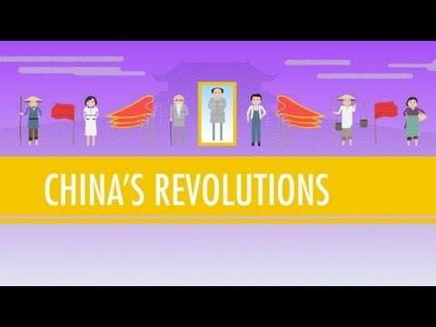

Slide 6
Create a double bubble, comparing and contrasting nationalism in India and China

