Slide 1
Pre-Revolutionary America
MSJC Political Science 101
Macdonald

Slide 2
Mayflower Compact
1620 41 men (w/ their women) boarded Mayflower for New World
Various reasons – some Pilgrims
Bound for English colony in VA, but landed in New England
Recognizing no gov’t / settlement, leaders insisted that all on board sign Mayflower Compact
Compact legalized their position as “civil body politic” under King James I – first instance of self government in New World in which system of laws dictated, not a single person or group

Slide 3
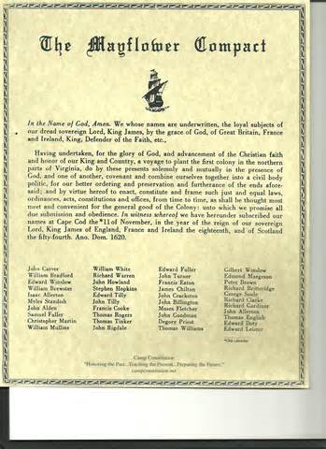

Slide 4
“Mixed system” of governance
As more ppl settled, several systems of colonial governance emerged
Most est. through charters from England – appointed governors to oversee
Many intellectuals favored self governance
“Mixed system” emerged w/ assemblies in which colonists elected representatives to speak on their behalfand counsel governors
All colonies had assembly, but had no legal authority

Slide 5
Tension
Worked until:
Growing factions of those who supported the Crown (often wealthy, land grants, etc.) and those who were suspicious of favored elite
French and Indian War – revenue needed, resulting in the Great Squeeze (Sugar Act 1764, Stamp Act 1765, Townshend Acts 1767, Tea Tax 1773) after period of salutary neglect

Slide 6
Sons of Liberty
Resistance groups started to emerge throughout America
Collectively known as Sons of Liberty
Led by ppl like John and Samuel Adams
Held rallies, sponsored letter writing campaigns – tried to shape public opinion
At times used intimidation and aggression
First interest groups

Slide 7
American Revolution
Two reasons for American Revolution:
Financial (Great Squeeze, tyrannical taxes)
Ideological (desire to create system in which all citizens (white, male, prpertied) had say in gov’t and were given basic freedoms

Slide 8
Philosophical Basis
Ideas of John Locke widely spread during this time
Two Treatises of Government, Locked argued that all legitimate gov’t based on consent of governed and individuals have natural rights
Later Adam Smith wrote about economic rights and limiting government to protect economic rights of citizens

Slide 9
Growing Unrest
In colonies, ppl started to write about liberty, including John Adams
1765 began publishing series of essays in which he offered defense of patriotism and liberty
Group gathered to discuss new taxes and consider responses and produced Declaration of Rights and Grievances – still not advocating a break from England

Slide 10
Concord & Lexington
After Boston Tea Party, every colony except GA sent delegates to First Continental Congress hoping to find compromise – produced boycotts
1775 MA gov ordered troops to seize what he though was supply of arms from colonists at Concord, shots fired at Lexington
Colonists met again at Second Continental Congress – produced Declaration of Independence

Slide 11
Declaration of Independence
Based on :
Natural rights (Locke) – individuals possess certain guarantees, can’t be taken away by gov’t
Social contract theory (Locke/ Hobbes) – ppl give up some freedom to gov’t in order to protect their lives and property – gov’ts always limited
Consent of the governed
Right to rebel – when government fails to be limited, obligation of ppl to change gov’t

Slide 12
A public opinion change?
Debate over how affected D. of I. was in galvanizing public opinion
In NY, group tore down statue of King George and melted into 42,000 bullets for war
Others continued to support King throughout revolution as seemed to gamble economic future

Slide 13
American Victory
Ultimate victory for America due to:
1. leadership of George Washington
2. Growing public support, esp. through “Crisis Papers” or Common Sense – Thomas Paine support for virtues of democracy - Washington ordered pamphlets read to all troops
3. support from French

