Slide 1
Scramble for Africa

Slide 2
Directions
Five groups – Choose countries
Read “Keeping Score”
Read specific instructions for your country

Slide 3
Procedure
When called on, you take any colony you want. You want it. You get it. But, if someone owns it, you roll the dice. Higher score keeps it.
Zulus always get the last roll in South Africa.
At end of game, highest point total wins.
HOWEVER, If the Zulus have South Africa at the end of the game, Zulus automatically win because they beat the Europeans.

Slide 4
Procedure
With your group, determine a tentative list of colonies (by number) you would like. Write them down on a scratch sheet of paper.
2. Your strategy may change as time goes on.

Slide 5
Procedure
Choose ONE color to represent your nation.
If you win a territory, put an small x on it.
At the END of the game, you will shade in all colonies that you end up owning.

Slide 6
The Game
Round One: Britain
Round Two: Britain and Portugal
Round Three: Britain, Portugal and France
Round Four: Britain, Portugal, France and Germany
Round Five and after: All nations

Slide 7
Debrief Questions:
Africa was actually divided up like this during the Berlin Conference? What might have been some drawbacks to this process?
When you were colonizing, did you take into account any tribal boundaries? What effect might this have later?
Why would European nations feel pride when colonizing these lands?
What did you gain from colonizing Africa?
How did the Industrial Revolution affect this process?

Slide 8
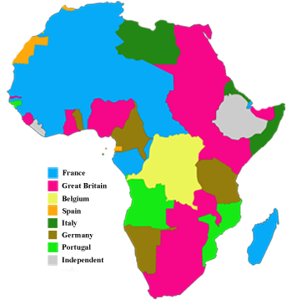
Africa, 1914

