Slide 1
Synthesis
Essay Skills

Slide 2
Synthesis Activity
In your group, look over the 10 images.
Pair them together in a way that makes sense to you (2).
Every photo must be paired with another image.
All of the images may only be used once.
Fill out the “Synthesis Activity” assignment sheet.

Slide 3
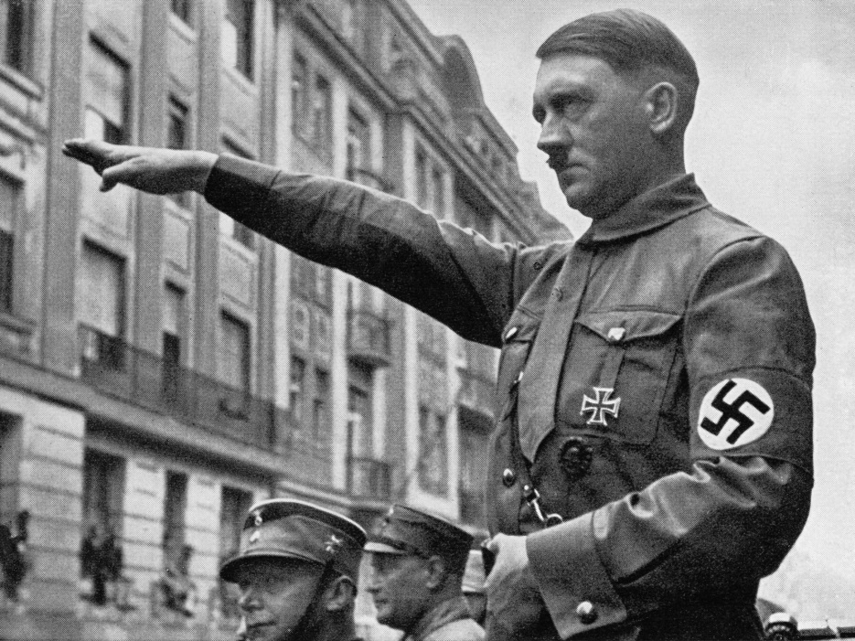

Slide 4
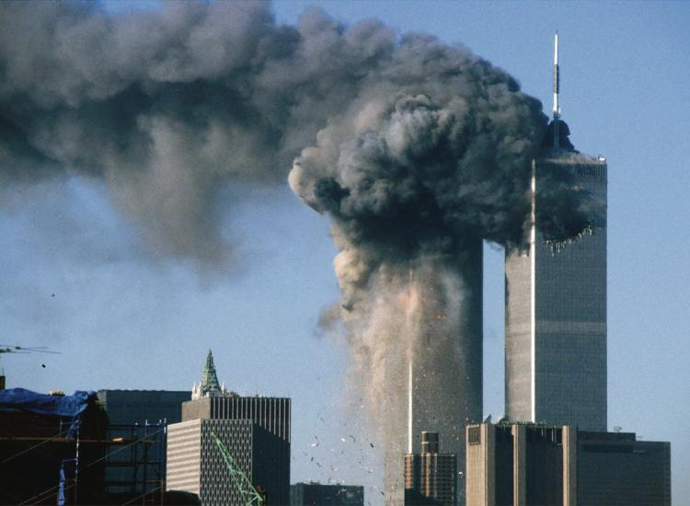

Slide 5
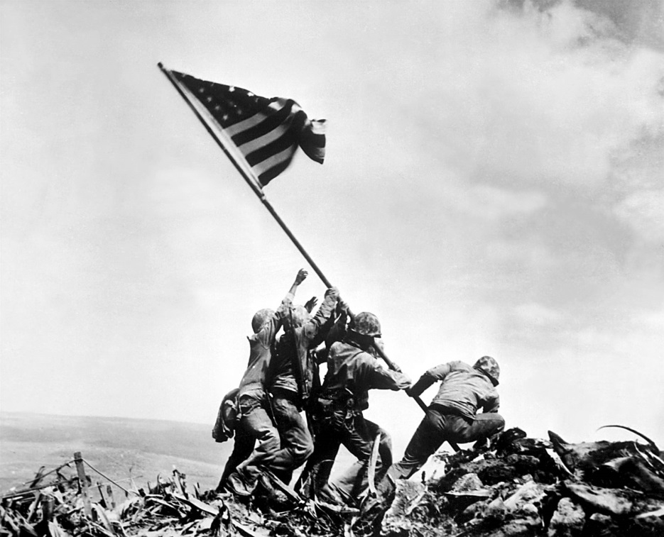

Slide 9
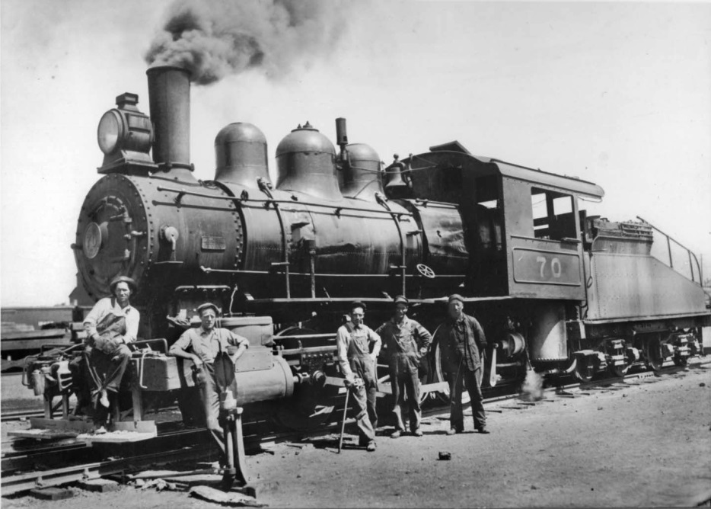

Slide 13
Synthesis
Extends an argument by explaining the connections between the argument and ONE of the following:
1) a different historical period, situation, era, or region
2) a different field of inquiry (e.g., a subject like math or geography)
***To get synthesis points on the essays, you must explain the connections.
***Think “Global Questions”

Slide 14
Synthesis Practice
The Roman Empire fell due to a combination of growing too large to govern and the resulting internal problems and outside pressures from nomadic peoples.
Assignment:
Write a synthesis statement for the thesis above.
Sentence Frame:
The fall of the Roman empire is similar to _______________ because _________________________. For example, _____________________.

