Slide 1
Treaty of Versailles
Macdonald
World History

Slide 2
Treaty of Versailles

Slide 3
Treaty of Versailles
Germany take full responsibility for war

Slide 4
Treaty of Versailles
Germany take full responsibility for war
Germans pay reparations

Slide 5
Treaty of Versailles
Germany take full responsibility for war
Germans pay reparations
Germans limit military to 100,000 troops

Slide 6
Treaty of Versailles
Germany take full responsibility for war
Germans pay reparations
Germans limit military to 100,000 troops
Rhineland demilitarized

Slide 7
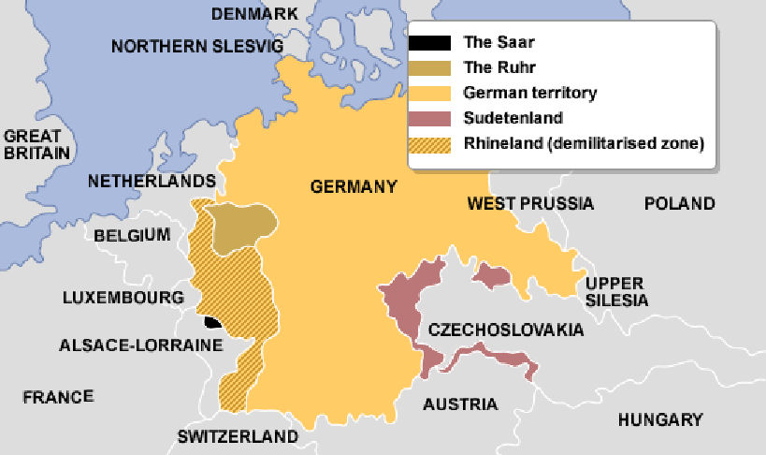

Slide 8
Treaty of Versailles
Germany take full responsibility for war
Germans pay reparations
Germans limit military to 100,000 troops
Rhineland demilitarized
No alliance between Germany and Austria

Slide 9
Treaty of Versailles
Germany take full responsibility for war
Germans pay reparations
Germans limit military to 100,000 troops
Rhineland demilitarized
No alliance between Germany and Austria
All former Russian land taken from Germany

Slide 10
Treaty of Versailles
Germany take full responsibility for war
Germans pay reparations
Germans limit military to 100,000 troops
Rhineland demilitarized
No alliance between Germany and Austria
All former Russian land taken from Germany
League of Nations created

